Slide 1


Unemployment & MIgratIon In Turkey
Team: Enıs Furkan kırmızı 150230740

Slide 2
Contents
Summary
Problem Definitions
Datasets & Sources
Research Questions & Proposed Tests
Unemployment & Migration Relation & Other Factors & Insight
Potential Products or How To Convert This Project To a Servıce or Product
Issues Related to Data Engineering
Issues Related to Ethics
Conclusion

Slide 3

Summary
This project aims to find the effects of unemployment on migration of Turkey and providing insightful information about both unemployment and migration.

Slide 4

Problem defınıtıons
The intricate relation between unemployment and migration in Turkey reveals regional disparities, youth migration trends, and the impact on specific groups.
Giving insight about both unemployment and migration trends in Turkey using visual charts.

Slide 5

Datasets
asa.xlsx is a distribution of age groups and gender of migrants in year 2022
Asa2.xlsx is a distribution of age groups and gender of migrants in years 2016-2022
Immigrants and emigrants by age group and sex, 2016-2022.xlsx is the original dataset of asa and asa2 files. These files are adjusted for easy usage.

Slide 6
Datasets
Immigration over Ethnicity.xlsx is a distribution over gender and ethnicities over years 2016-2022.
Net Migration of Regions.xlsx is net migration of 12 subregions of Turkey over years 2008-2022.
Poverty rates over years.xlsx is a distribution of poverty rate over education level and poverty risk over years 2016-2022.

Slide 7
Datasets
Reasons of internal migration.xlsx is a distribution of reasons why and how much people migrate internally over years 2018-2022.
Unemployment rate over gender and education.xlsx is a distribution of education levels unemployment rates over years 2014-2022.
Unemployment rate over years.xlsx is a distribution of genders unemployment rates over years 2016-2022.
Unemployment Rates of Regions over Years.xlsx is a distribution of unemployment rates of regions over years 2014-2022.

Slide 8

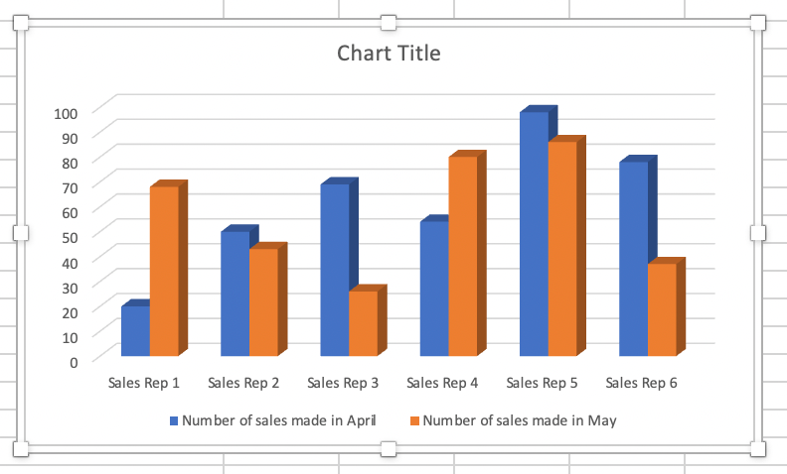
Source of vısual charts and graphs
notebook.ipynb file shows how all visualisations made and how data is merged. Source code resides in it.

Slide 9

Source
https://data.tuik.gov.tr/
All data belongs to Turkish Statistical Institution (TSI). Chosen themes are Employment, Unemployment and Wage, Population and Demographics, Income, Life, Consumption and Poverty.
Subthemes are Immigration, Emigration, Poverty Rates, Unemployment Rates, Total Population
All data is provided in Project folder.

Slide 10

Source

Slide 11

Research Questıons and Proposed tests
How does the unemployment rate vary across different regions in Turkey?
Are certain regions more prone to high unemployment rates than others?
What is the correlation between unemployment and internal migration?
Do young individuals migrate more frequently in search of employment opportunities?
Are highly educated individuals more likely to migrate internally for better job prospects?

Slide 12
Research Questıons and Proposed tests
How does the educational level of individuals influence their decision to migrate for employment?
Are economic factors the main driving force, or are there other significant contributors?
Are there specific age groups or gender-related patterns in migration for job opportunities?

Slide 13
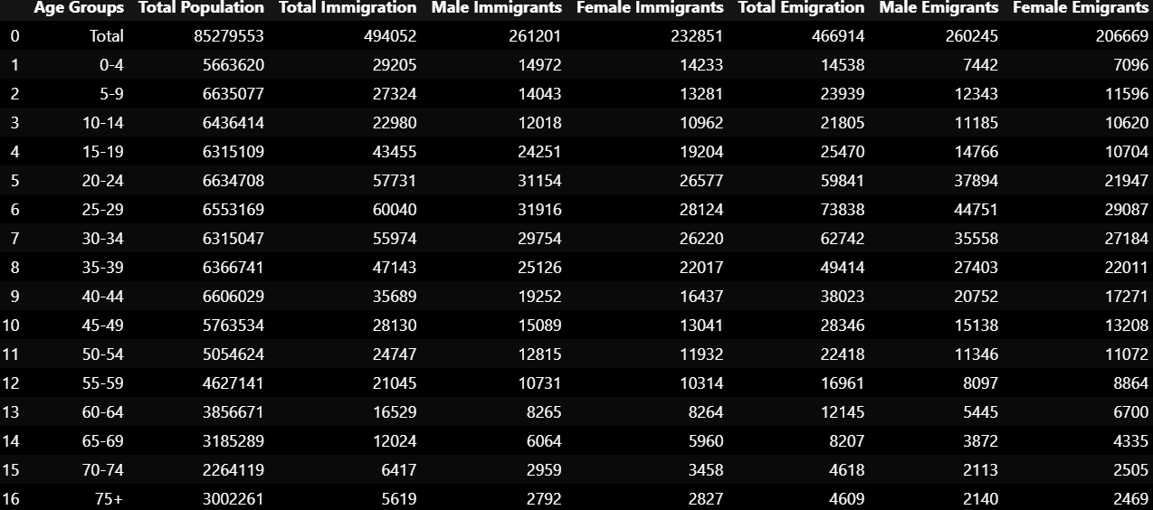
Mıgratıon Dıstrıbutıon by Age Groups and gender ın 2022

Slide 14
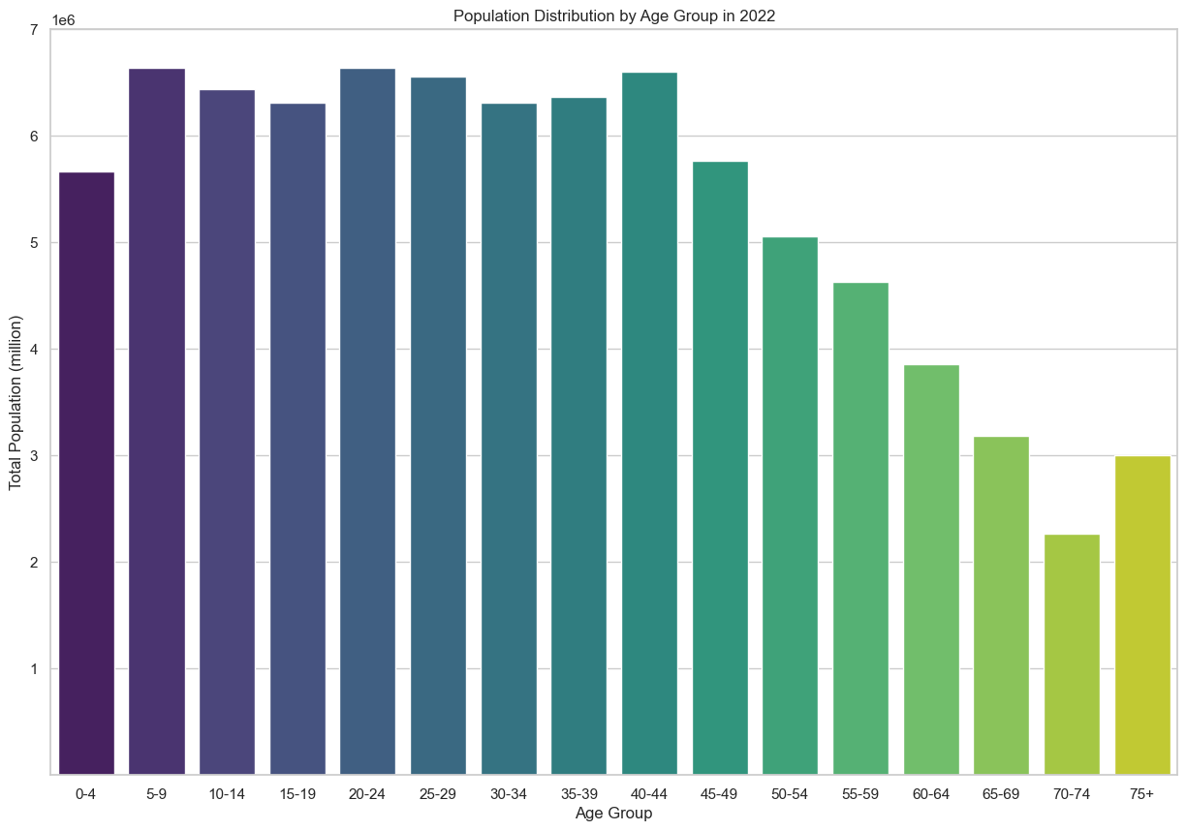
Takıng a look at populatıon ın 2022
In 2022, Turkey had a total population of 85.279.553 which makes the country one of the most populous countries in the region. It can be inferred that Turkey has very dominantly young generations out of most population.
It can be said that labor force will remain young and strong for decades. Making this young population join the work force is crucial for development.
The labor force in Turkey is diverse, with various sectors contributing to economic activities. Key sectors include agriculture, industry, and services.
However, taking a look at why people migrate internally and internationally is good to see how it can affect the population of Turkey.

Slide 15
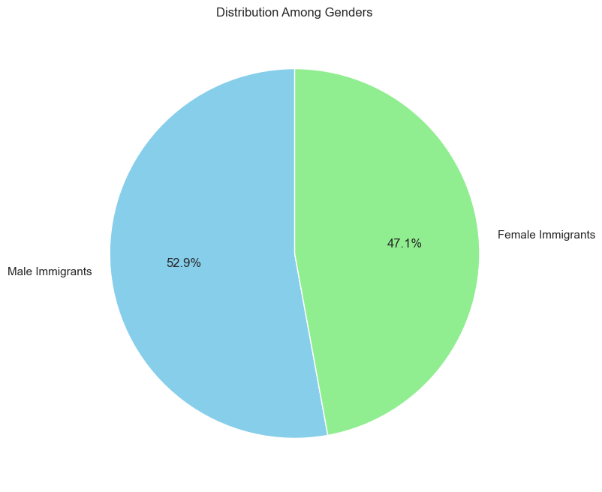
Immıgratıon among genders
According to 2022’s data, the distribution of immigrants in Turkey shows a noticeable difference among genders.
The data reveals a difference of 5.8% immigrants between male and female immigrants. Male immigrants constituting 52.9% of the total immigrant population while female immigrants constitute 47.1%.
It can be said that males are slightly more into migrating to Turkey than females. Turkish Government can integrate these people and help them take part in labor force to contribute economy.
Further analysis and exploration of the factors contributing to this gender distribution could provide valuable insights into the dynamics of migration patterns in Turkey.

Slide 16
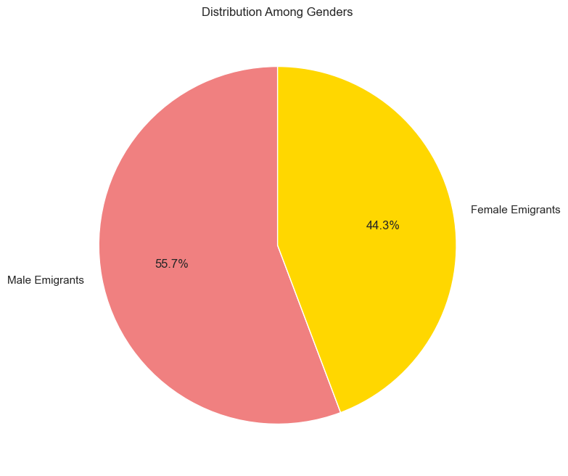
Emıgratıon among genders
Emigration trends among genders in 2022 are slightly more male dominant than immigration trends among genders in 2022.
There is a notable 11.4% difference among genders participating in emigration. The data indicates that 55.7% consists of male emigrants and 44.3% consists of female emigrants out of total emigrants. It can be said that males are more likely to emigrate than females.
Further investigation into the causes of and consequences of this gender distribution among emigrants could provide valuable insights about migration dynamics in Turkey.
These insights may help government to see patterns and making decisions, policies and strategies.

Slide 17
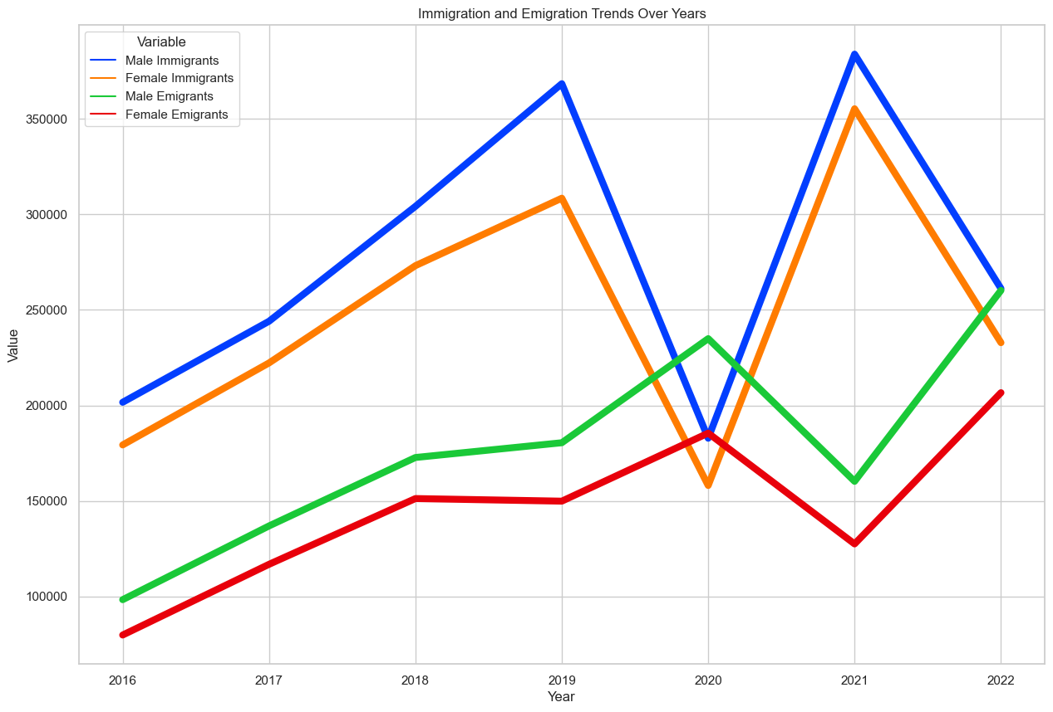
Immıgratıon AND EMIGRATION trends over years
In years 2016-2022, immigration is higher where almost doubles the emigration except 2020. That year is the only year emigration is slightly higher than immigration due to drastical fall of immigration.
From 2016 to 2022, emigration rises near 250%. Between same years, immigration starts to rise up to 2019 then a fall occurs even below 2016 numbers in 2020. After that it recovers in 2021 and falls again to around 25000 in 2022.
As said previously, male migrants are more likely to both emigrate and immigrate than females.
According to table, the patterns of genders are the closely same.

Slide 18
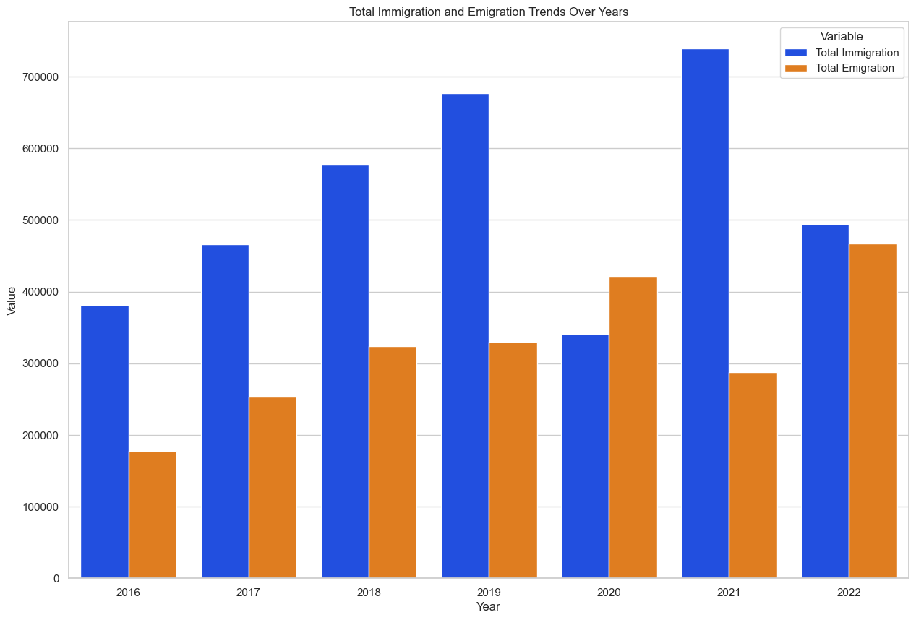
Total ımmıgratıon and emıgratıon trends over years
In years between 2016 and 2022, total immigration is higher than total emigration except year 2020. It can be inferred that migrants affect Turkey’s population positively over years.
In 2021, there is a record of over 700000 people immigrated in Turkey. In 2022, there
İs a record of over 400000 people emigrated out of Turkey.
It is worth noting that in 2020, something may have occured that total immigration decreased drastically and total emigration increased slightly.

Slide 19
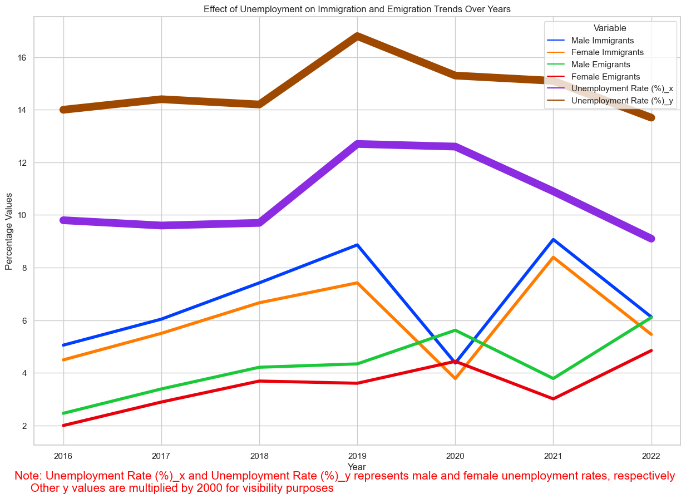
Effect of Unemployment on Immıgratıon and Emıgratıon Trends Over Years
In years between 2016 and 2022, female unemployment is always higher than male unemployment. The increase and decrease patterns are almost the same.
Turkey had a record of both male and female unemployment rates of around 13% male and 17% female unemployment rates respectively.
Despite the record of unemployment, the rate of people immigrating increased and the rate of people emigrating stayed the same. After 2019, this situation changed in an opposite way and after that it returned to 2019 levels in 2021.
According to data, it can be said that unemployment is not the only reason why people immigrate and emigrate.

Slide 20
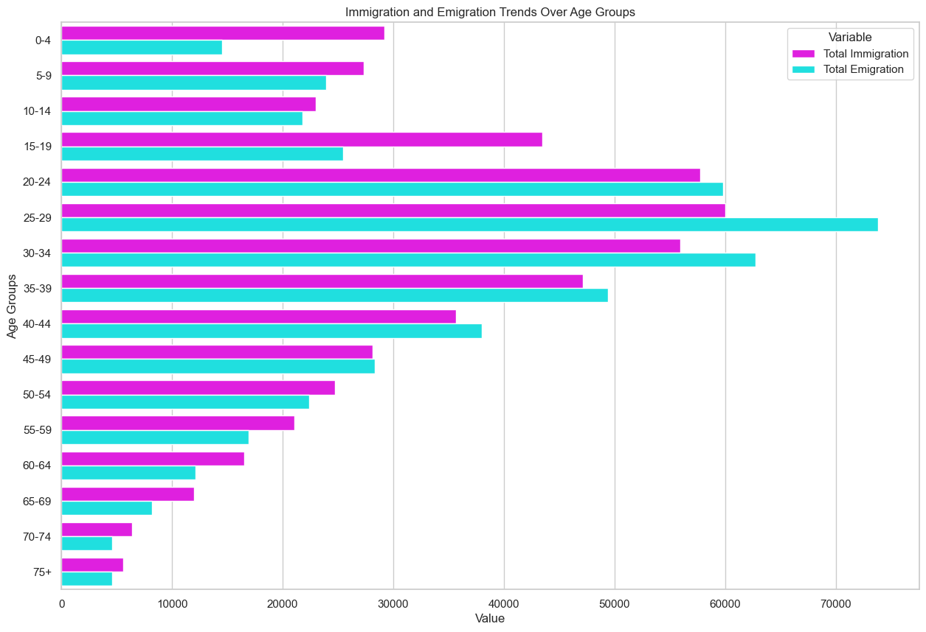
Immıgratıon and Emıgratıon Trends Over Age Groups In 2022
From the given data, it is clear to say that people who are older are massively more likely not to emigrate or immigrate. However, in ages between 25-29, there are over 70000 emigrantst and 60000 immigrants.
These young people are in their best productive stages of their lives and they emigrate from Turkey, so researching reasons why these people migrate is beneficial for Turkey to make them participate in workforce.
In younger but not children people are emigrating more than they immigrate and other age groups are immigrating more than they emigrate.
It can be inferred that middle aged people are more likely to move.

Slide 21
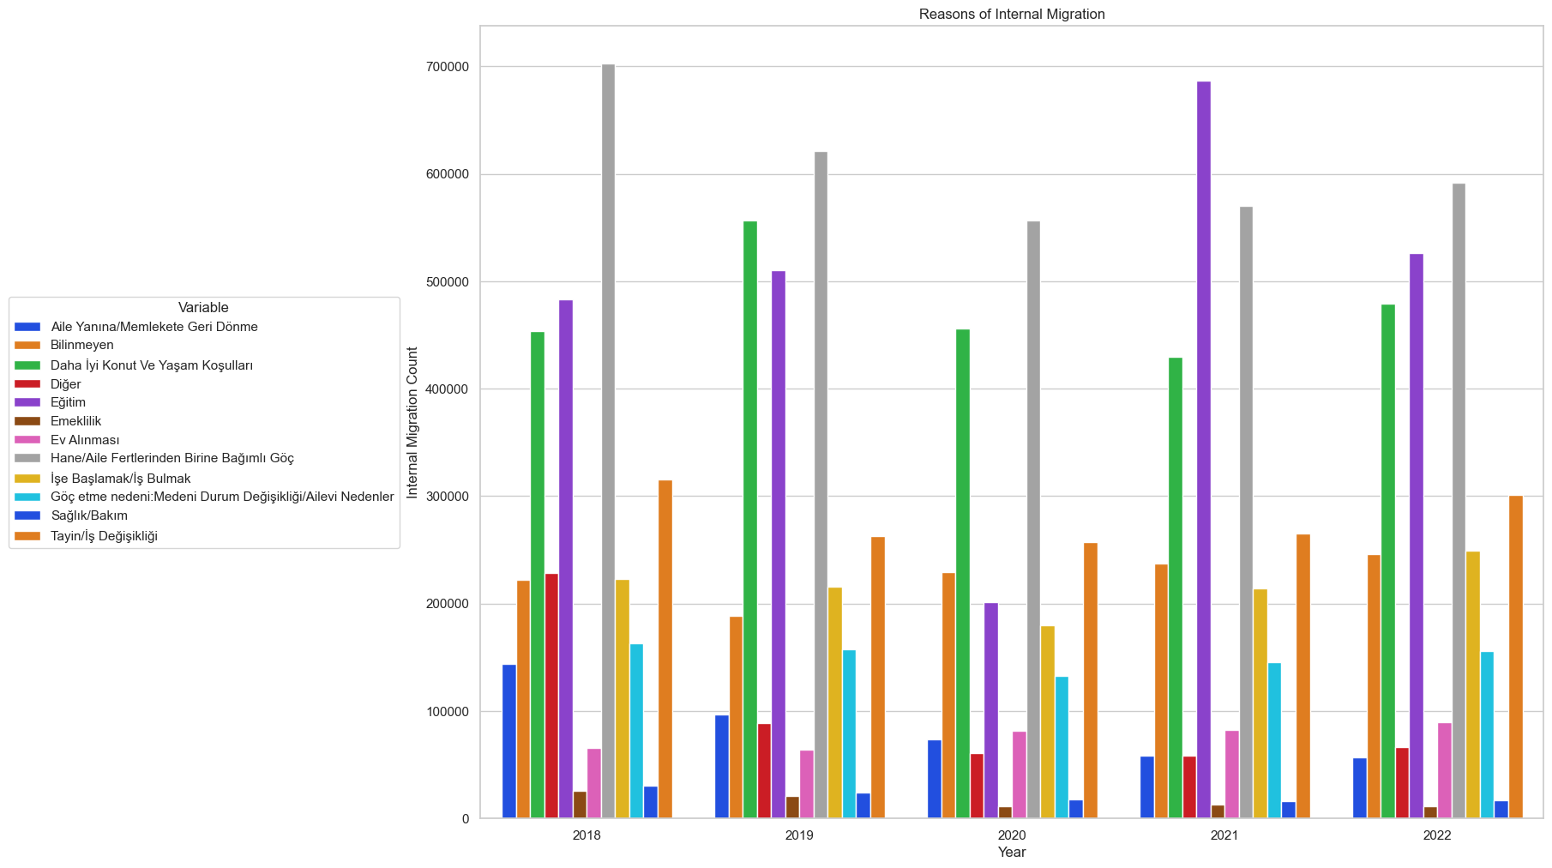
Reasons of Internal MIgratıon
In years between 2018 and 2022, people migrated internally most of because their family moved except year 2021 where education is the number one reason and family is second.
There are 3 reasons that are the biggest motivations people migrate internally which are move of family, education and better housing and living conditions.
After these reasons there comes unknown reasons, migrating for job, job change, marriage, other reasons.
People migrated internally the least because of retirement. So it can be inferred that people mostly stayed where they are after retirement.

Slide 22
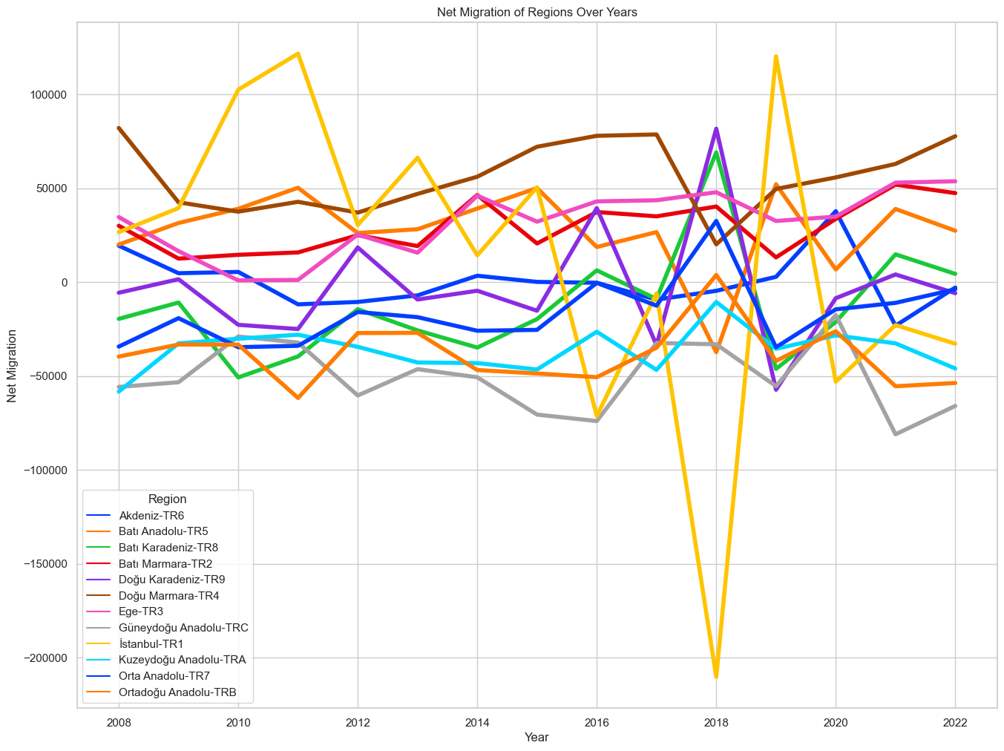
Net Mıgratıon of Regıons Over Years
From the years between 2008 and 2022, different regions of Turkey’s net migration numbers are given in the data. There is a noticeable change in Istanbul’s graph in 2018 where the city lost around 200.000 people.
The regions that are gaining people over years are East Marmara, Istanbul except year 2018, Aegea, West Anatolia, West Marmara.
The regions that are losing people over years are South East Anatolia, Middle East Anatolia, North East Anatolia, West Blacksea, Middle Anatolia.
Regions like Mediterranian Sea and East Blacksea is waving around 0 net change.

Slide 23
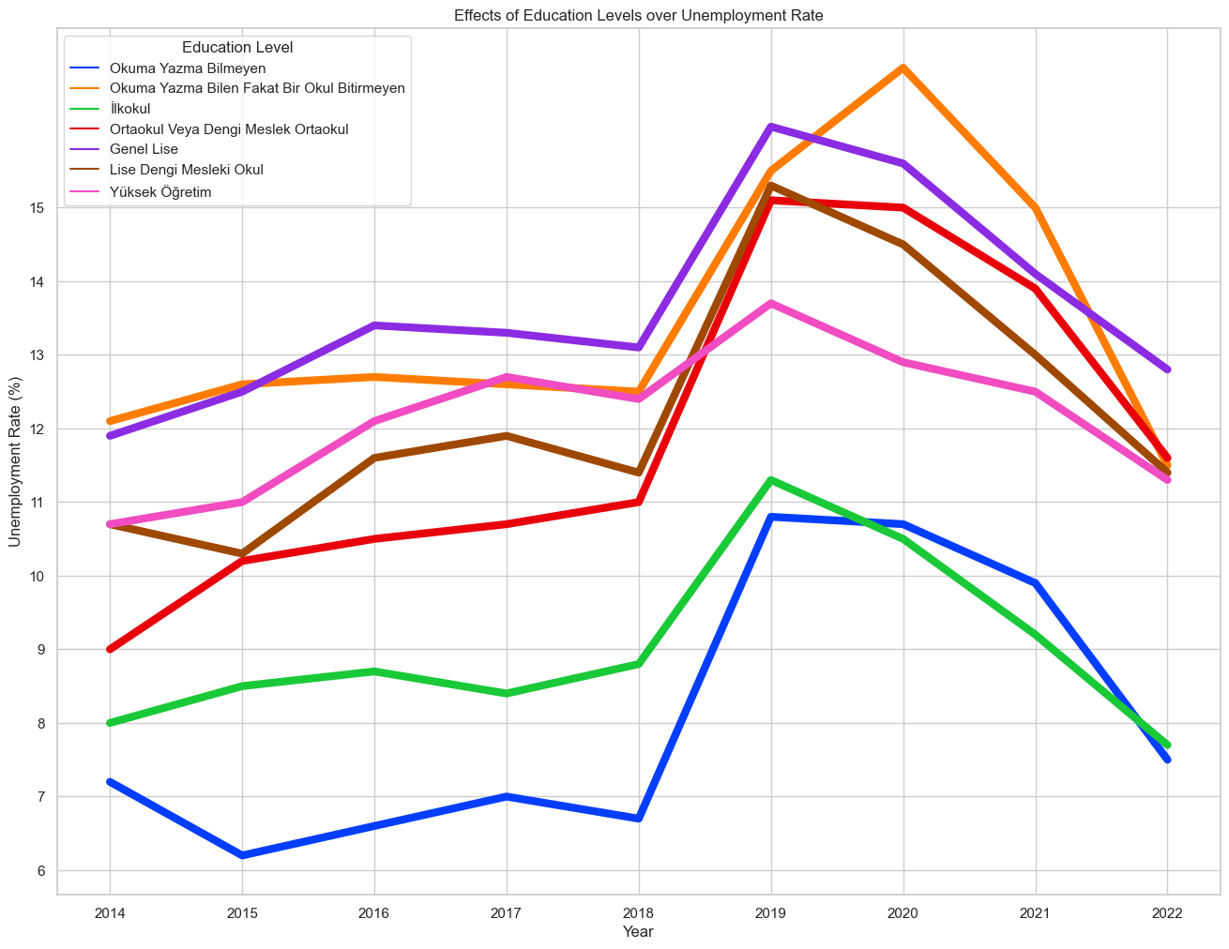
Effects of Educatıon Levels over Unemployment Rate
In Turkey between years 2014 and 2022, high school graduates and people who know reading and writing but hava not finished a school are facing the most unemployment rates. But except primary school graduates and people who don’t know reading or writing, other education levels face unemployment rates that are higher and closer to each other.
After 2018, there is a massive increase in unemployment around the whole education levels then it begins to decrease slowly over years.
Looking at the data there are roughly 1 people out of 10 that are unemployed in Turkey.
It is worth noting that people who have higher education are more prone to be unemployed.

Slide 24
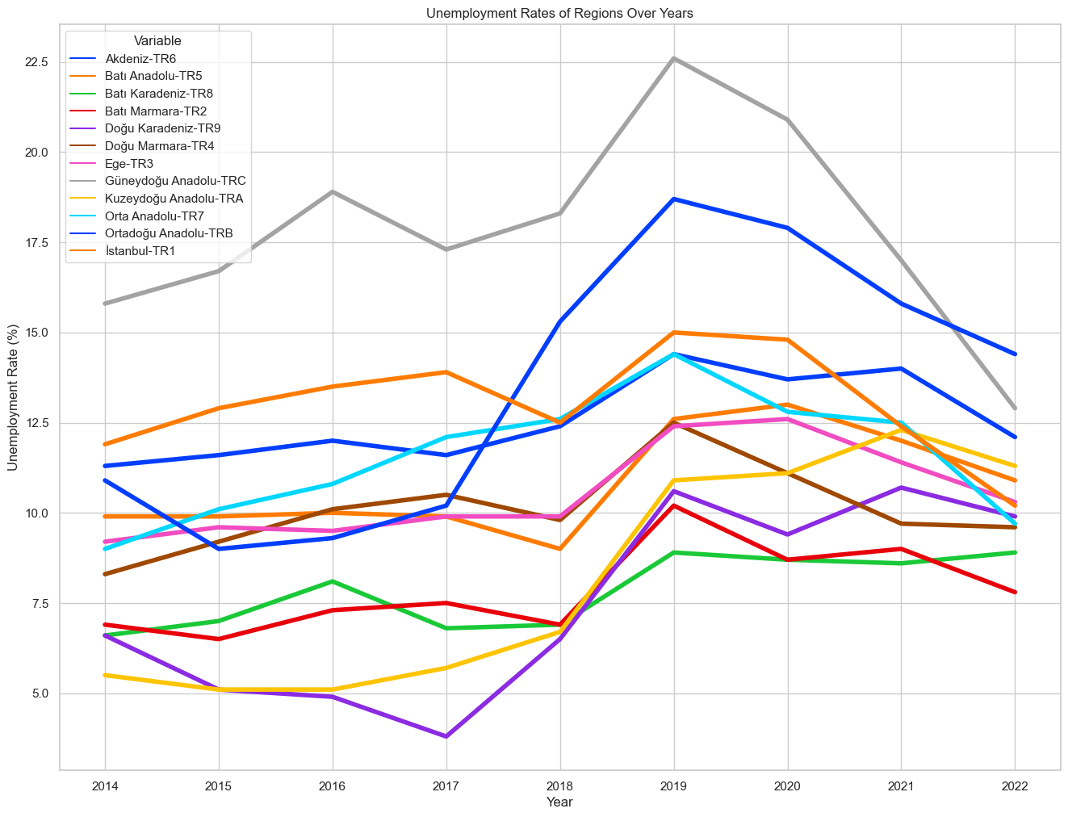
Unemployment Rates of Regıons Over Years
In years between 2014 and 2022, according to the data, South East Anatolia is outlying most of the years in unemployment rates. It peaks at 22.5% percent of unemployment. It can be inferred that the region is prone to high unemployment rates.
The least unemployment record is in 2017 at East Blacksea around 2.5%. After 2018, unemployment increases drastically at all regions until 2019 and decreases slowly for most regions.
It can be said that economy started to go in a bad way in 2018. Also noticing that Mediterranian Sea unemployment rate has increased drastically after 2017.

Slide 25
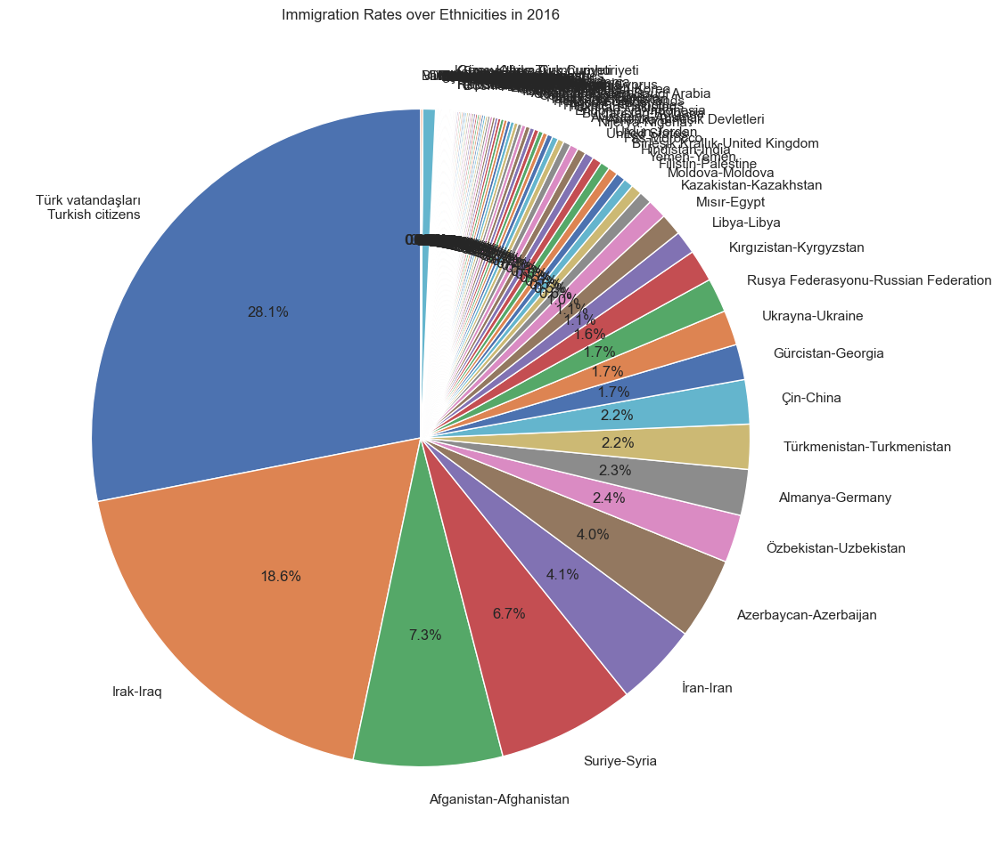
Immıgratıon Rates over Ethnıcıtıes ın 2016
From the data in year 2016, Turkish
Citizens have the highest immigration numbers with 28.1% and after that with 18.6% Iraq immigrants makes the majority of total immigrants.
It is worth noting that the countries where immigrants came from are so diverse.

Slide 26
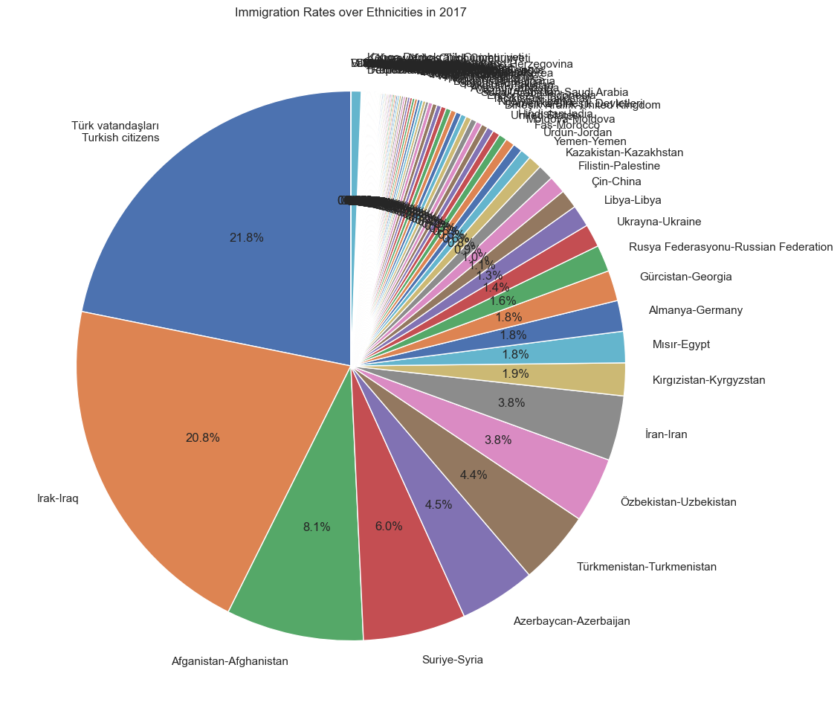
Immıgratıon Rates over Ethnıcıtıes ın 2017

Slide 27
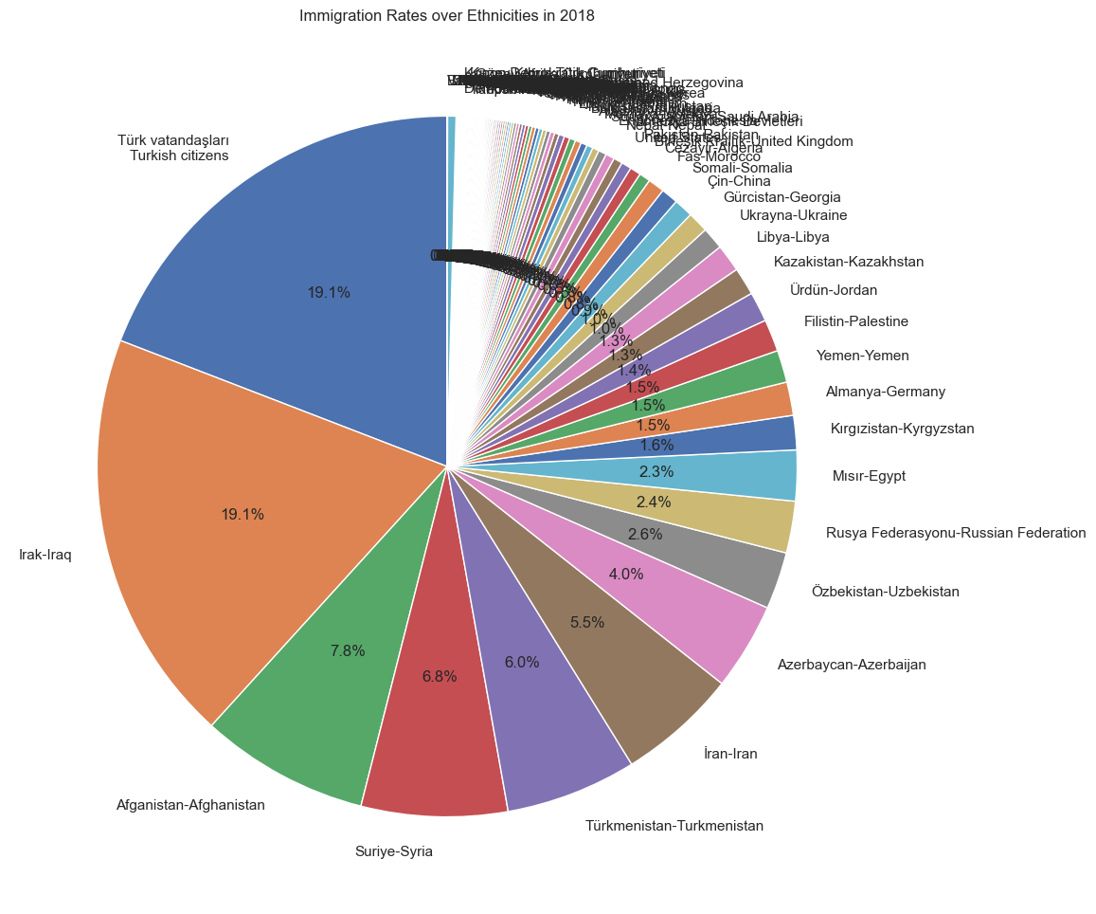
Immıgratıon Rates over Ethnıcıtıes ın 2018

Slide 28
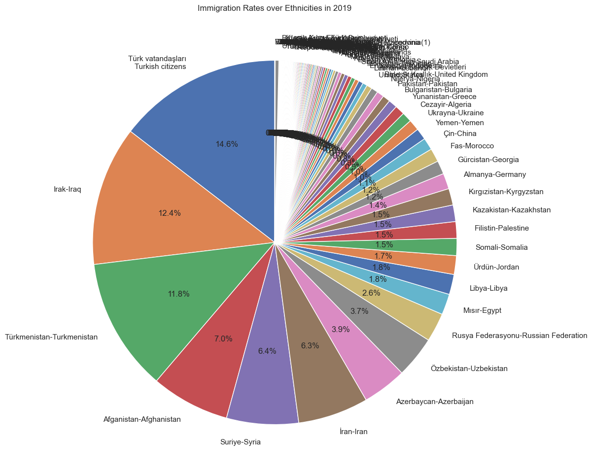
Immıgratıon Rates over Ethnıcıtıes ın 2019

Slide 29
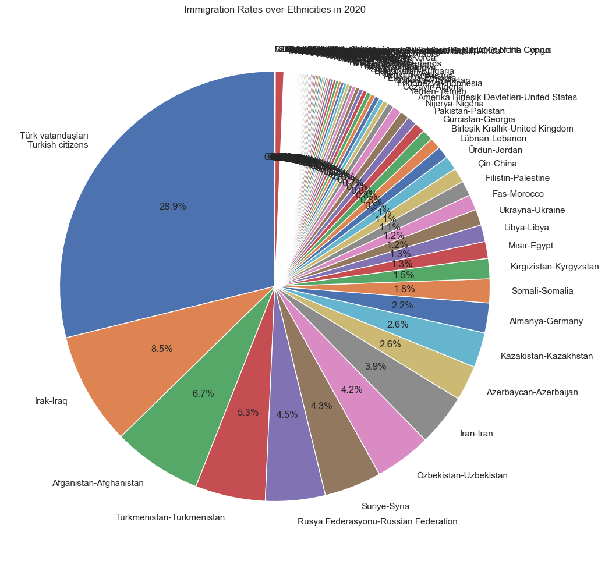
Immıgratıon Rates over Ethnıcıtıes ın 2020

Slide 30
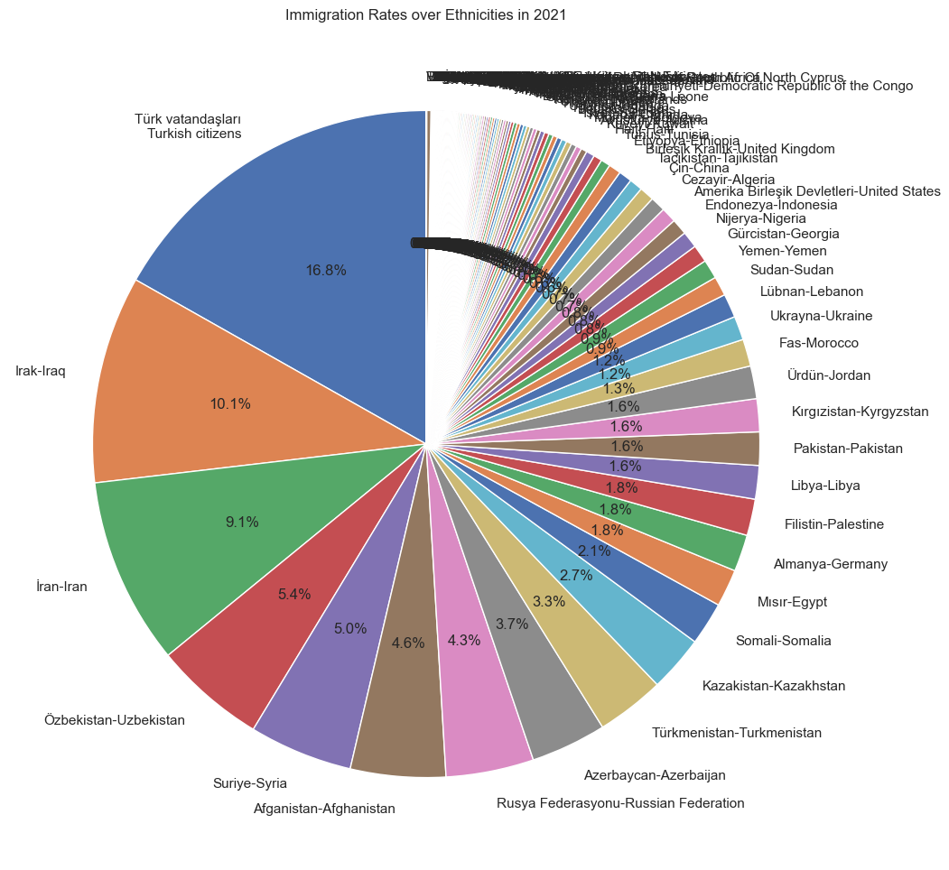
Immıgratıon Rates over Ethnıcıtıes ın 2021

Slide 31
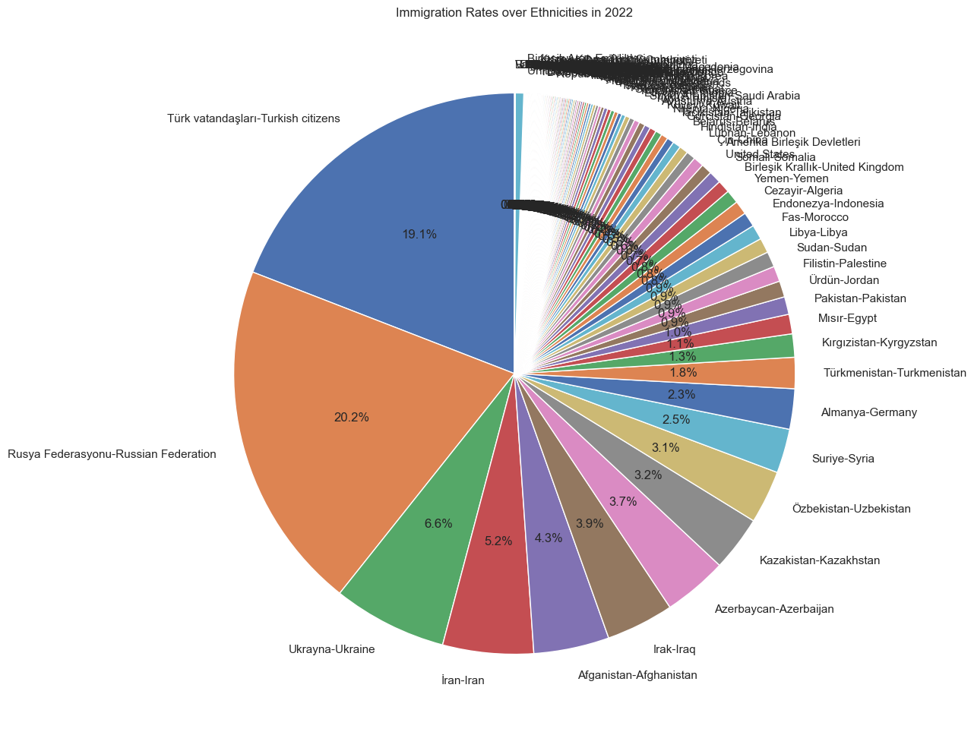
Immıgratıon Rates over Ethnıcıtıes ın 2022
In 2022, Russian immigrants are the biggest part of the pie chart and Ukrain is also a big part. This situation occured when the war breaks between two countries. Noticing how important the events in the world affect immigration is important.

Slide 32
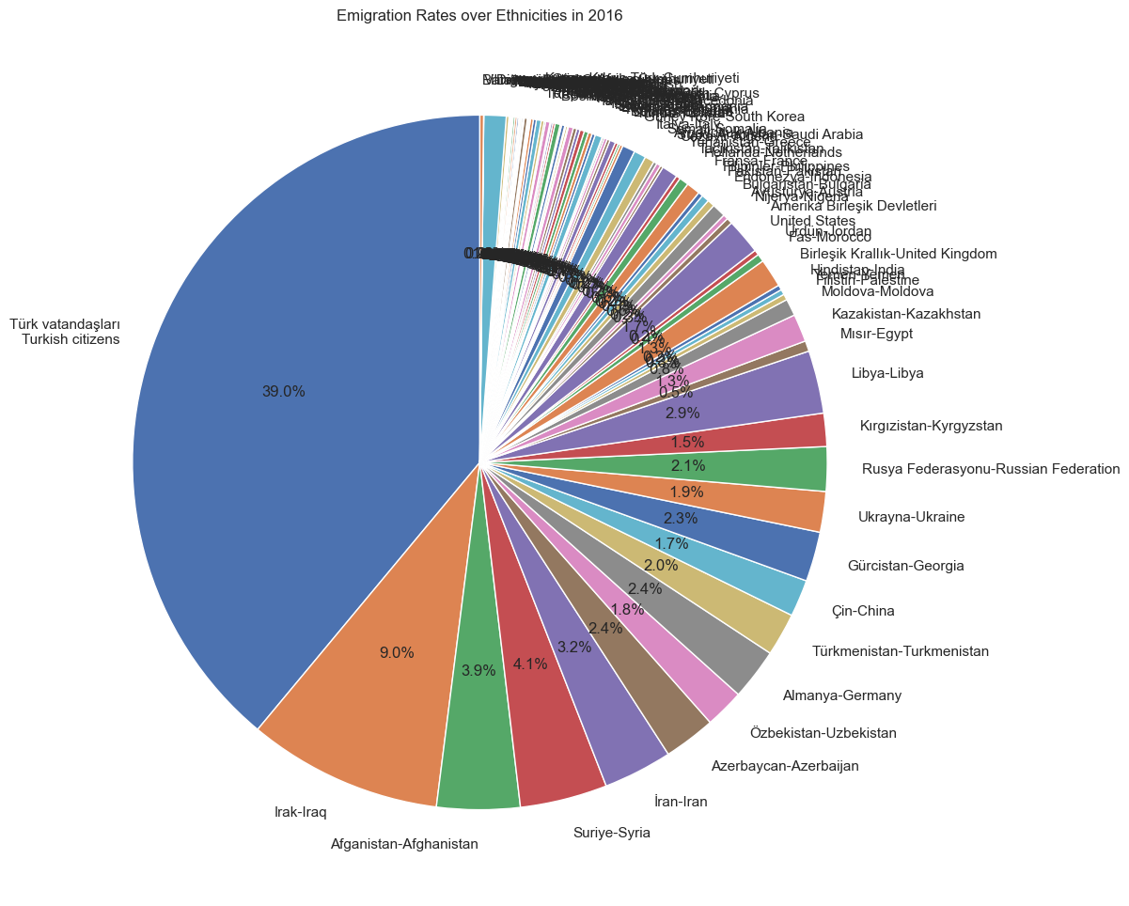
Emıgratıon Rates over Ethnıcıtıes ın 2016

Slide 33
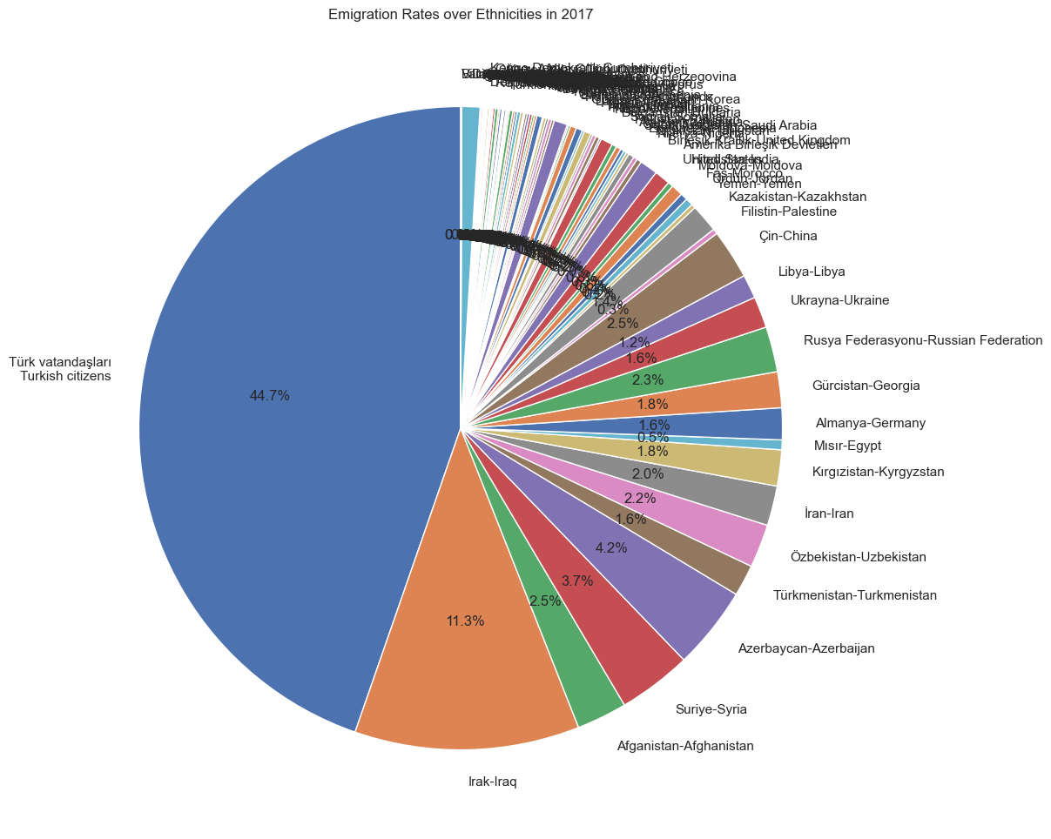
Emıgratıon Rates over Ethnıcıtıes ın 2017

Slide 34
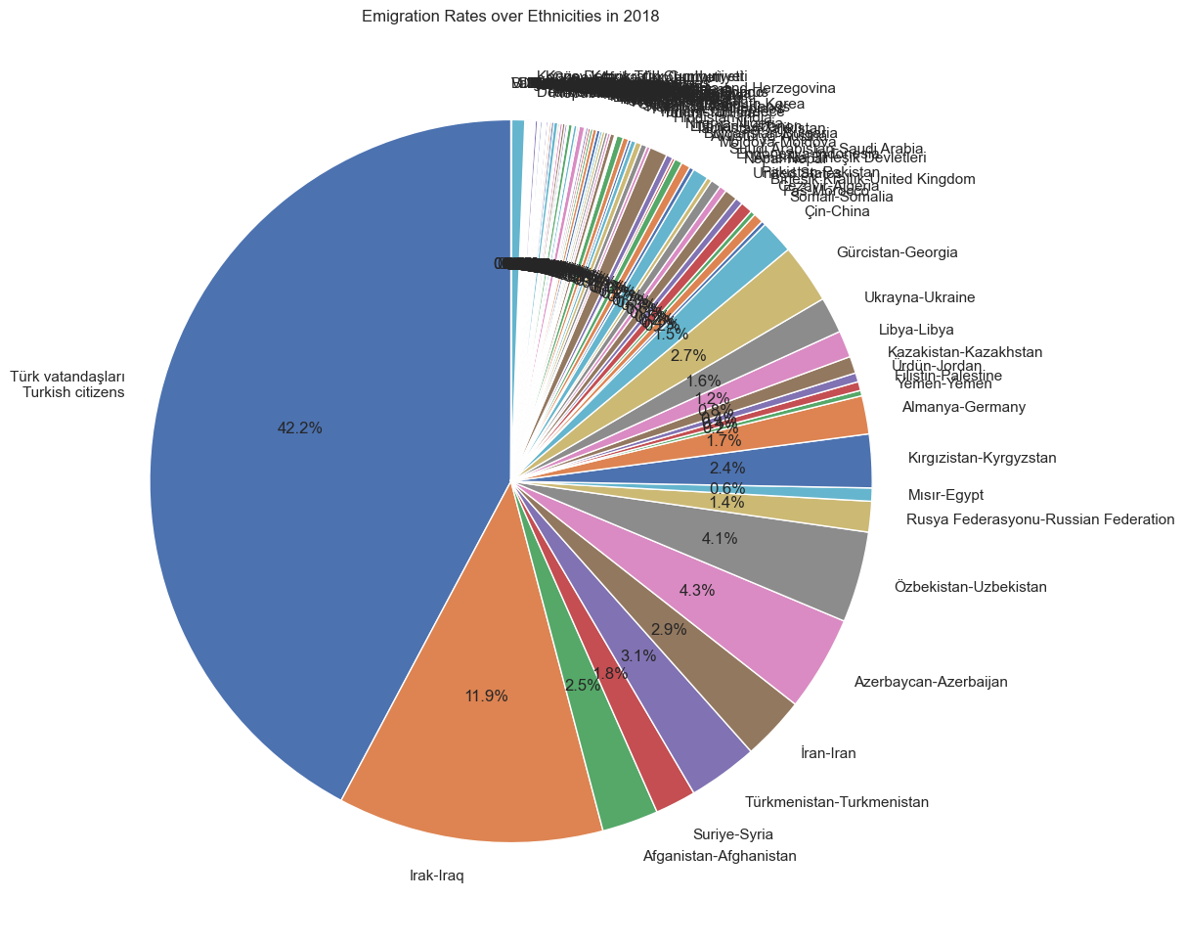
Emıgratıon Rates over Ethnıcıtıes ın 2018

Slide 35
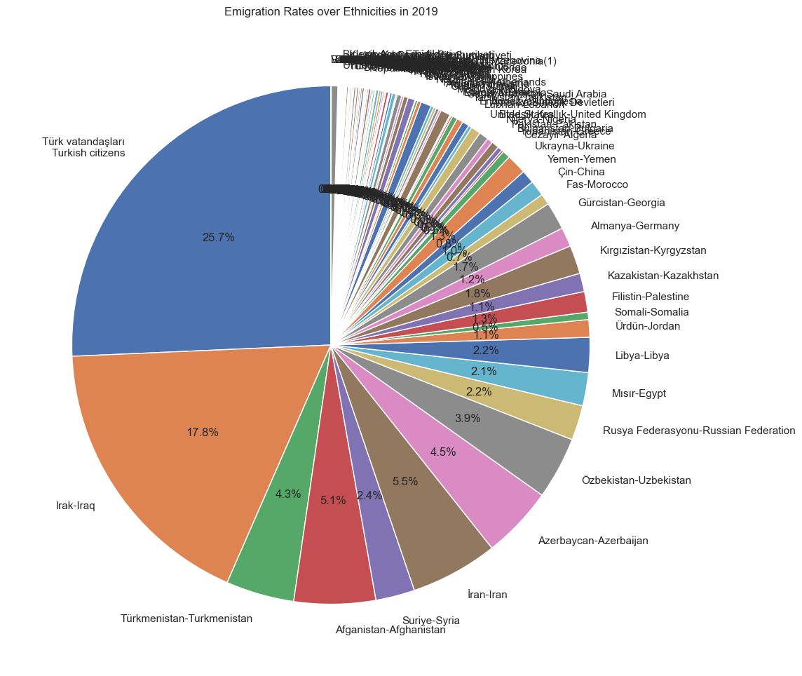
Emıgratıon Rates over Ethnıcıtıes ın 2019

Slide 36
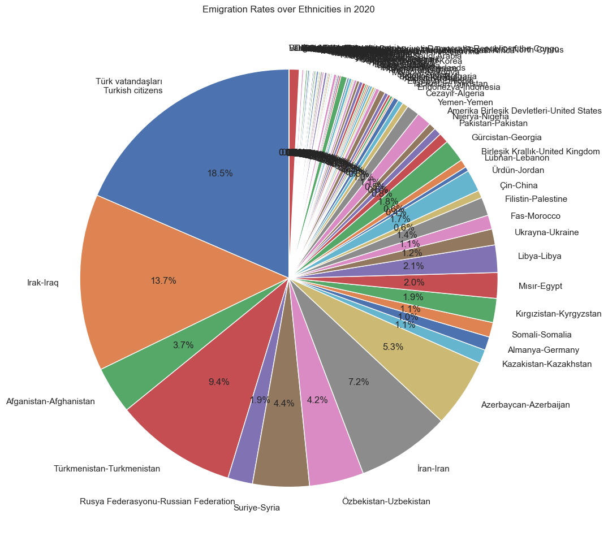
Emıgratıon Rates over Ethnıcıtıes ın 2020

Slide 37
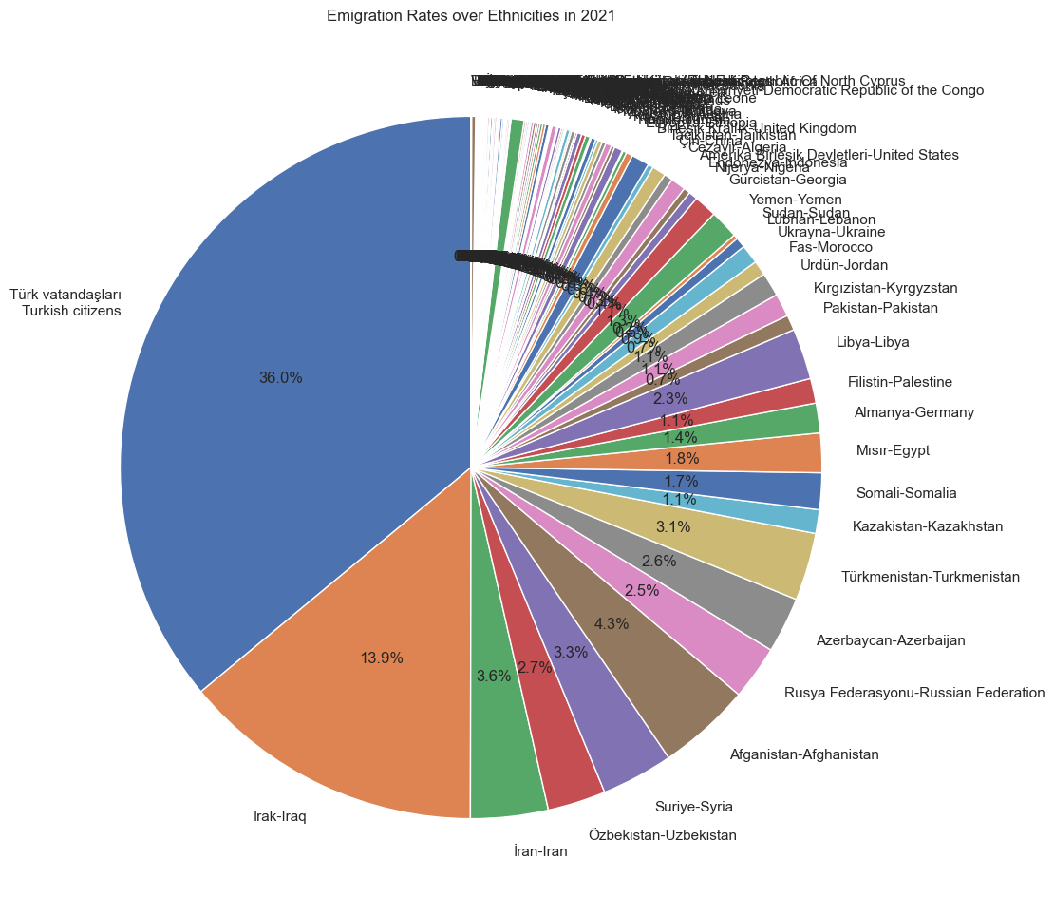
Emıgratıon Rates over Ethnıcıtıes ın 2021

Slide 38
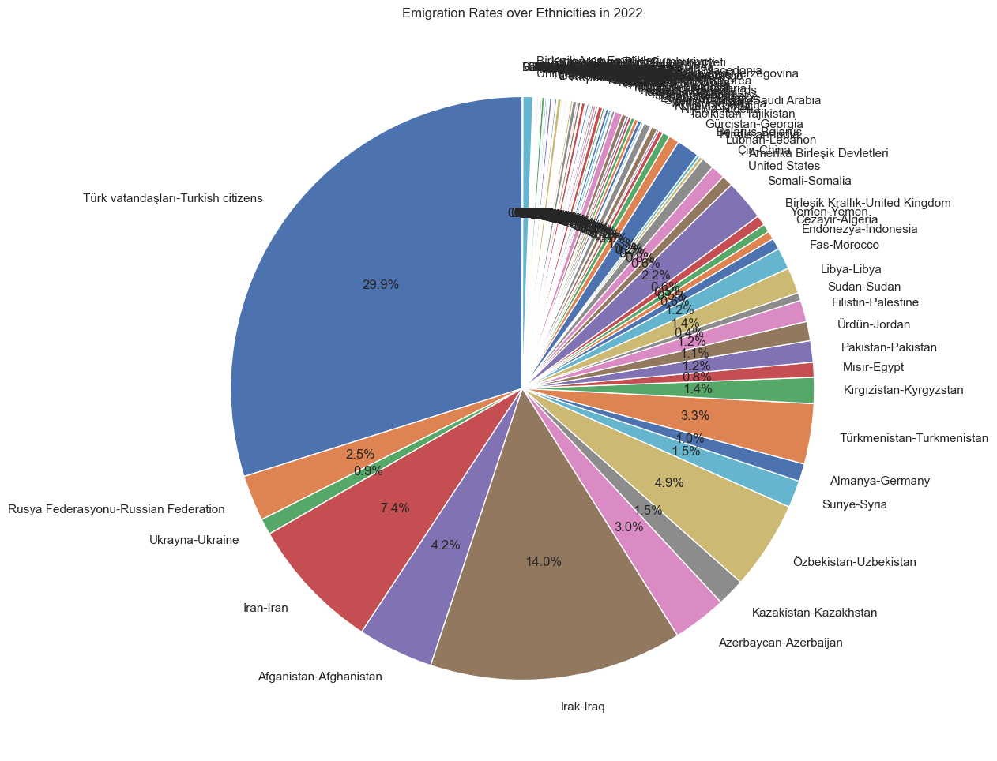
Emıgratıon Rates over Ethnıcıtıes ın 2022

Slide 39
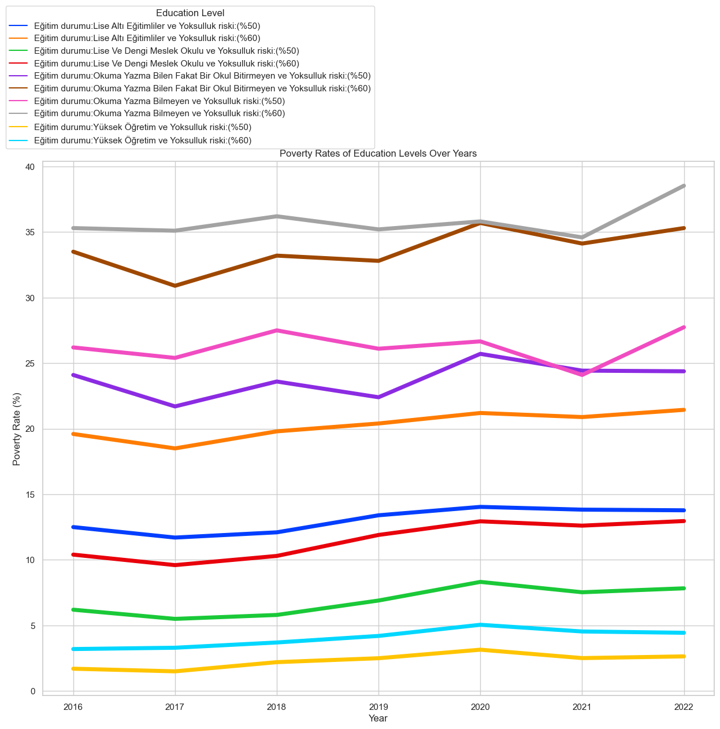
Poverty Rates of Educatıon Levels Over Years
In years between 2016 and 2022 in Turkey, poverty rates of education levels does not change substantially. Each education level has diverse poverty rates and it stays almost the same over years.
It is crucial noting that poverty rate decreases drastically when education level increases. The lowest poverty rate is on university graduates and the highest are people who dont know reading or writing or knows but have not finished a school. It can be inferred that if education level of people is generally increased, then poverty rates may fall generally.
The lowest point is around 2% of poverty rate and the highest is around 36% of poverty rate. The difference near 34% over all years which is massively high. Also over all these years, no event seems to have affected the poverty rate much. The relation between poverty and education is so strong.

Slide 40
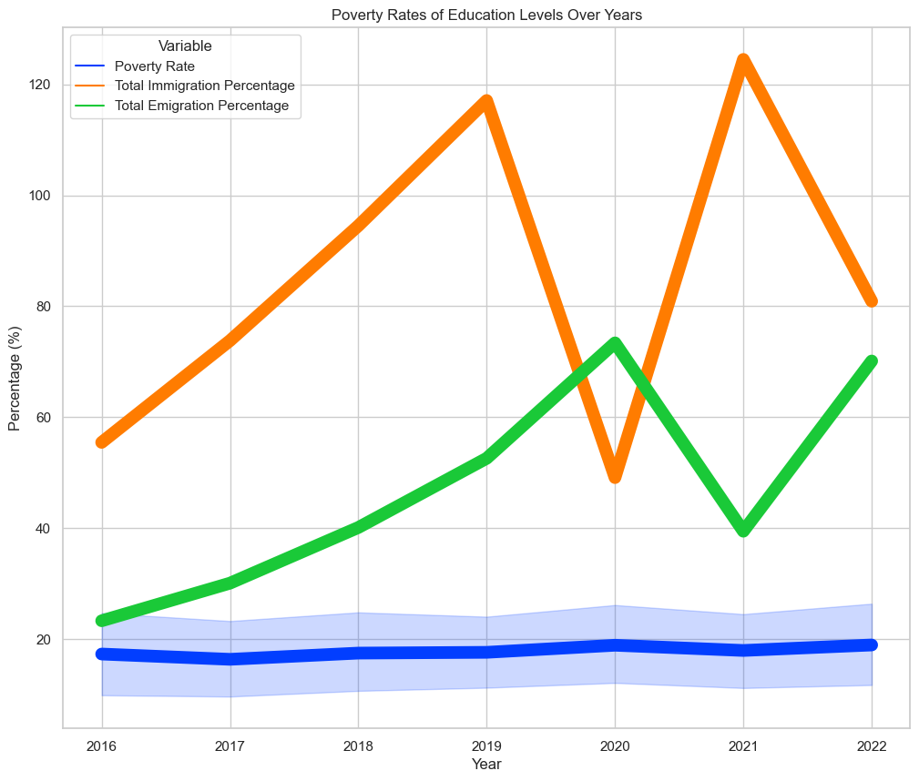
The effect on mıgratıon of Poverty Rates of Educatıon Levels Over Years
There does not a clear corelation exist between poverty rates of education levels and migration in Turkey. But it can be said that people may have been immigrating because of the stability of poverty rates until 2019. Something may have occured and a drastical drop in immigration and an increase in emigration happened. But after that it recovered in 2021 and some other event may have occured again.

Slide 41
Potentıal products or how to convert thıs project to a servıce or product
This report can be used to help government to make decisions, policies and measurements to address problems that are the reasons why people emigrate and guiding to solve them, address reasons why people don’t contribute to workforce and address why people migrate internally instead of contributing the economy of their region, spot the regions that are prone to poverty and unemployment.
This report can be used as a guide generally to where government and business should make investments.

Slide 42
ıssues related to data engıneerıng
Certain limited years are in the dataset so making future predictions may not be so reliable using ML methods.
Some datasets have too many breakpoints to visualize, had to make adjustments in the original data.
Some excel tables had unwanted text out of matrix that makes it difficult to process

Slide 43
Issues related to ethıcs
People may not want to share their data publicly.
There are no personal information in used datasets.
Other than that this report can be used as a guide that has no harm.

Slide 44
Conclusıon
According to data, there are no direct effects of unemployment on migration. But there are multiple reasons that have effects on migration both internally and internationally.
There is a corelation of migration with: age, gender difference, regional disadvantages, events that happened in certain years, ethnicity, economy, some personal reasons.
There is a corelation of unemployment with: education level, gender, regional disadvantages, economy, events that happened in certain years

Slide 45
THANK YOU end

